Slide 1
Journey
Map
Deepthi Peter
Associate Data Engineer

Slide 2
Timeline
Business Intelligence
28th Aug
Data
Warehouse
29th Aug
DMBS
22nd Aug
DevOps
24th Aug
Testing
23rd Aug

Slide 3
Soft Skills (14/08/2023)
Key learnings -
Professionalism and etiquette
Understood the difference between a college setting and a corporate setting through an activity
Present yourself in a polished way, be willing to contribute and take responsibility
Dress appropriately, follow the dress code
Time management and punctuality
Manage tasks effectively
Always be on time
Commitment
Reach out when you need help, do not delay tasks because you did not know how to do them

Slide 4
Soft Skills (16/08/2023)
Key learnings –
Chat, Call and Video Call etiquette
Use appropriate greetings when reaching out to someone through chat, call or video call
Be concise and to the point
Listening vs. hearing
Carried out an activity similar to Chinese whisper – taught us to be attentive and listen to others
Carried out a team activity to understand the importance of teamwork

Slide 5
Soft Skills (17/08/2023)
Key learnings –
Email etiquette – the right way to write an email
Communication skills
Listen, understand and empathize
Body language and voice are important while communicating
Presentation skills
Voice modulation
Body language
Hand gestures
Keep it interactive

Slide 6
Business Analysis and Agile (18/08/2023)
Key learnings –
What is business analysis
Enabling change in an organizational context by defining needs and recommending valuable solutions
Requirement analysis – functional and non-functional requirements
Software models – waterfall, iterative, agile, etc.
Agile & Scrum – various terminologies like sprint, scrum master, stand up meetings, stakeholders
Benefits of scrum
Adaptability
Continuous improvement
Efficient development process
Faster problem resolution

Slide 7
Business Analysis and Agile (21/08/2023)
Key learnings –
Learnt the processes involved in a daily stand-up meeting with scrum master, product owner, business analyst, development team, etc. through a team activity
Backlogs – sprint backlog and product backlog
Azure DevOps – Hands-on
Explore various features of Azure DevOps – create organization, project, sprint
Add epics, user stories, tasks and issues to the backlog
Add test plans and run tests on the tasks
Visualize tasks on Kanban board

Slide 8
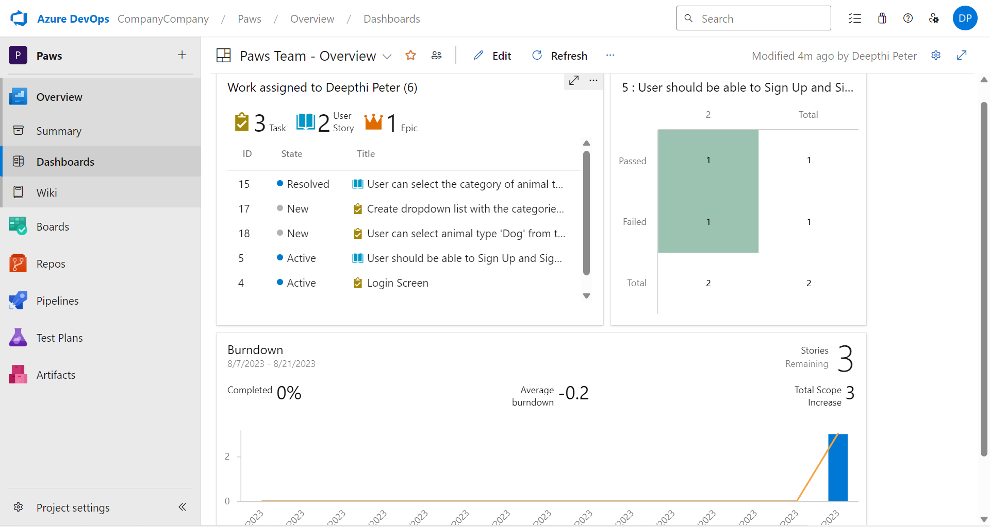
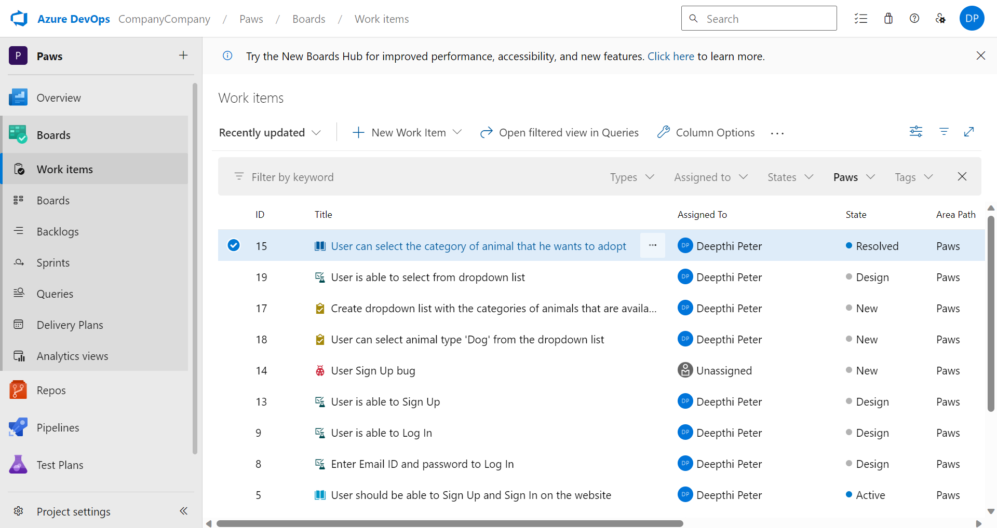
Azure DevOps (21/08/2023)

Slide 9
DBMS (22/08/2023)
Key learnings –
Database and database management system
DDL, DML, DQL, DCL, TCL
SQL – SELECT, WHERE, ORDER BY, GROUP BY, HAVING etc.
Hands-on session on SQL, executed simple queries
Normalization – 1NF, 2NF, 3NF, BCNF, 4NF, 5NF
Joins – Inner join, full outer join, left join, right join, cross join

Slide 10
Testing (23/08/2023)
Key learnings –
What is Software testing?
An activity carried out to identify bugs/defects/errors in a software system under development in order to provide error-free software
SDLC and STLC, different phases of STLC
Static and dynamic testing
White box, grey box and black box testing
Automation testing to reduce manual effort involved in testing
Unit testing to test logically isolated code

Slide 11
DevOps (24/08/2023)
Key learnings –
Incorporating DevOps for speedy delivery of software to customers
The DevOps lifecycle – continuous development, integration, testing deployment, monitoring, feedback and operations
Introduction to various DevOps tools – Jenkins, Nagios, Git, Ansible

Slide 12
Cloud Computing (25/08/2023)
Key learnings –
Cloud Computing and its characteristics
Cloud service models (IaaS, PaaS, SaaS)
Set up GitHub account, create a repository
Create a VM on Azure
GitHub actions

Slide 13
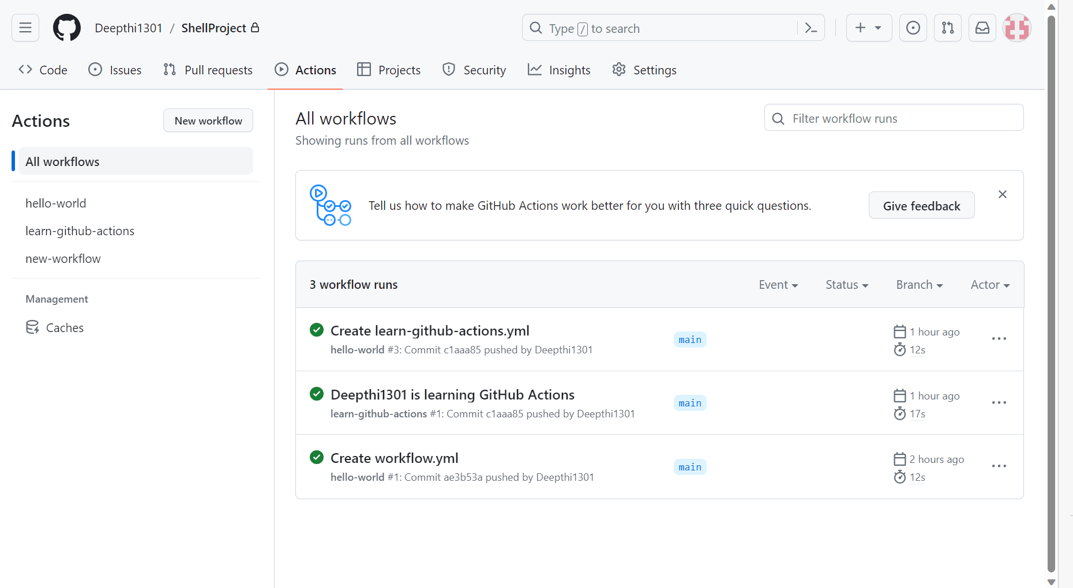
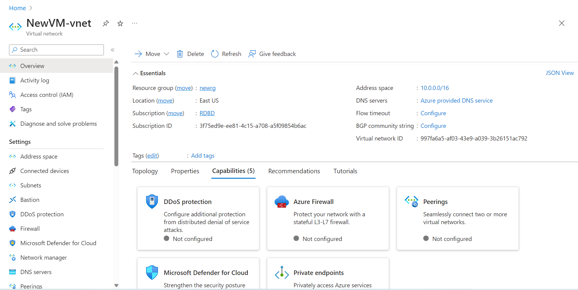
GitHub Actions
VM on Azure

Slide 14
Thank You

